Slide 1
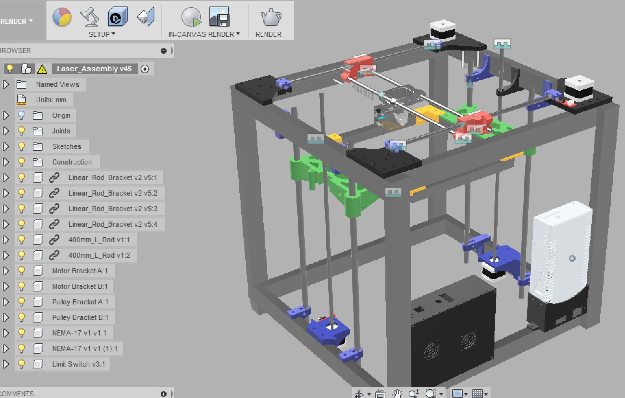
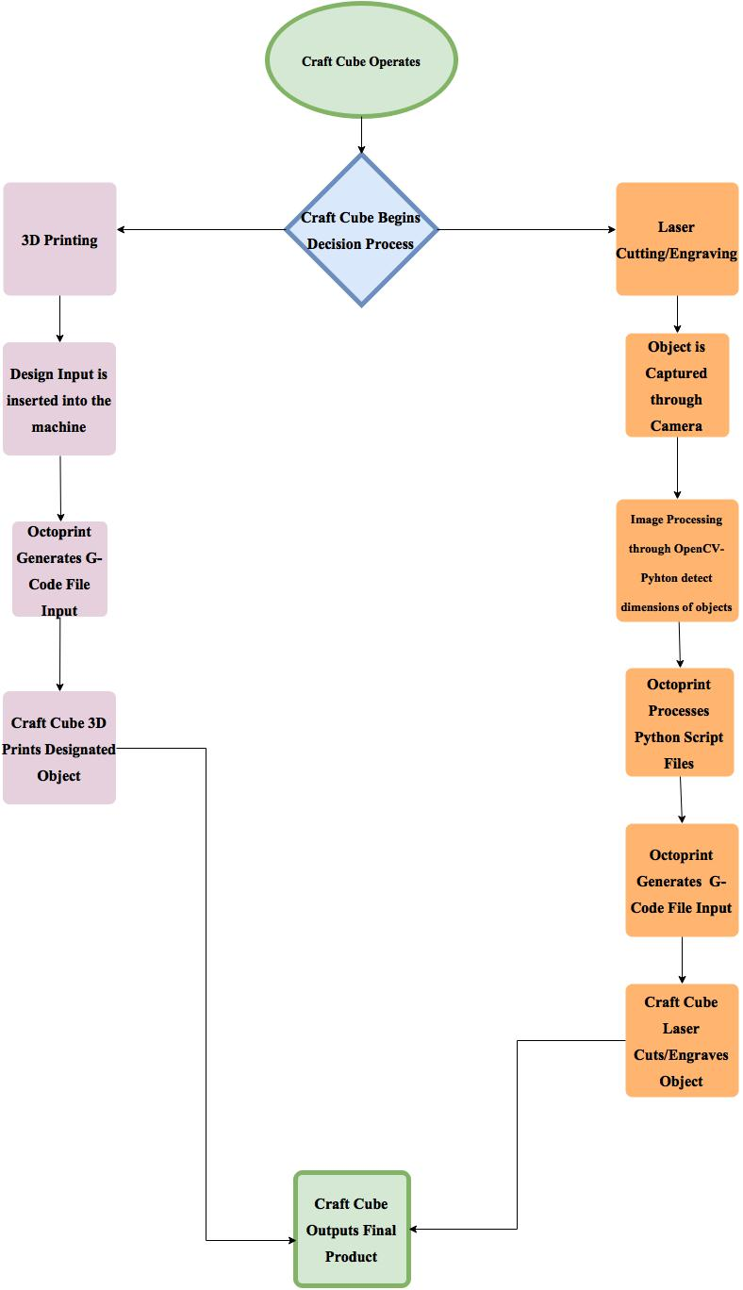
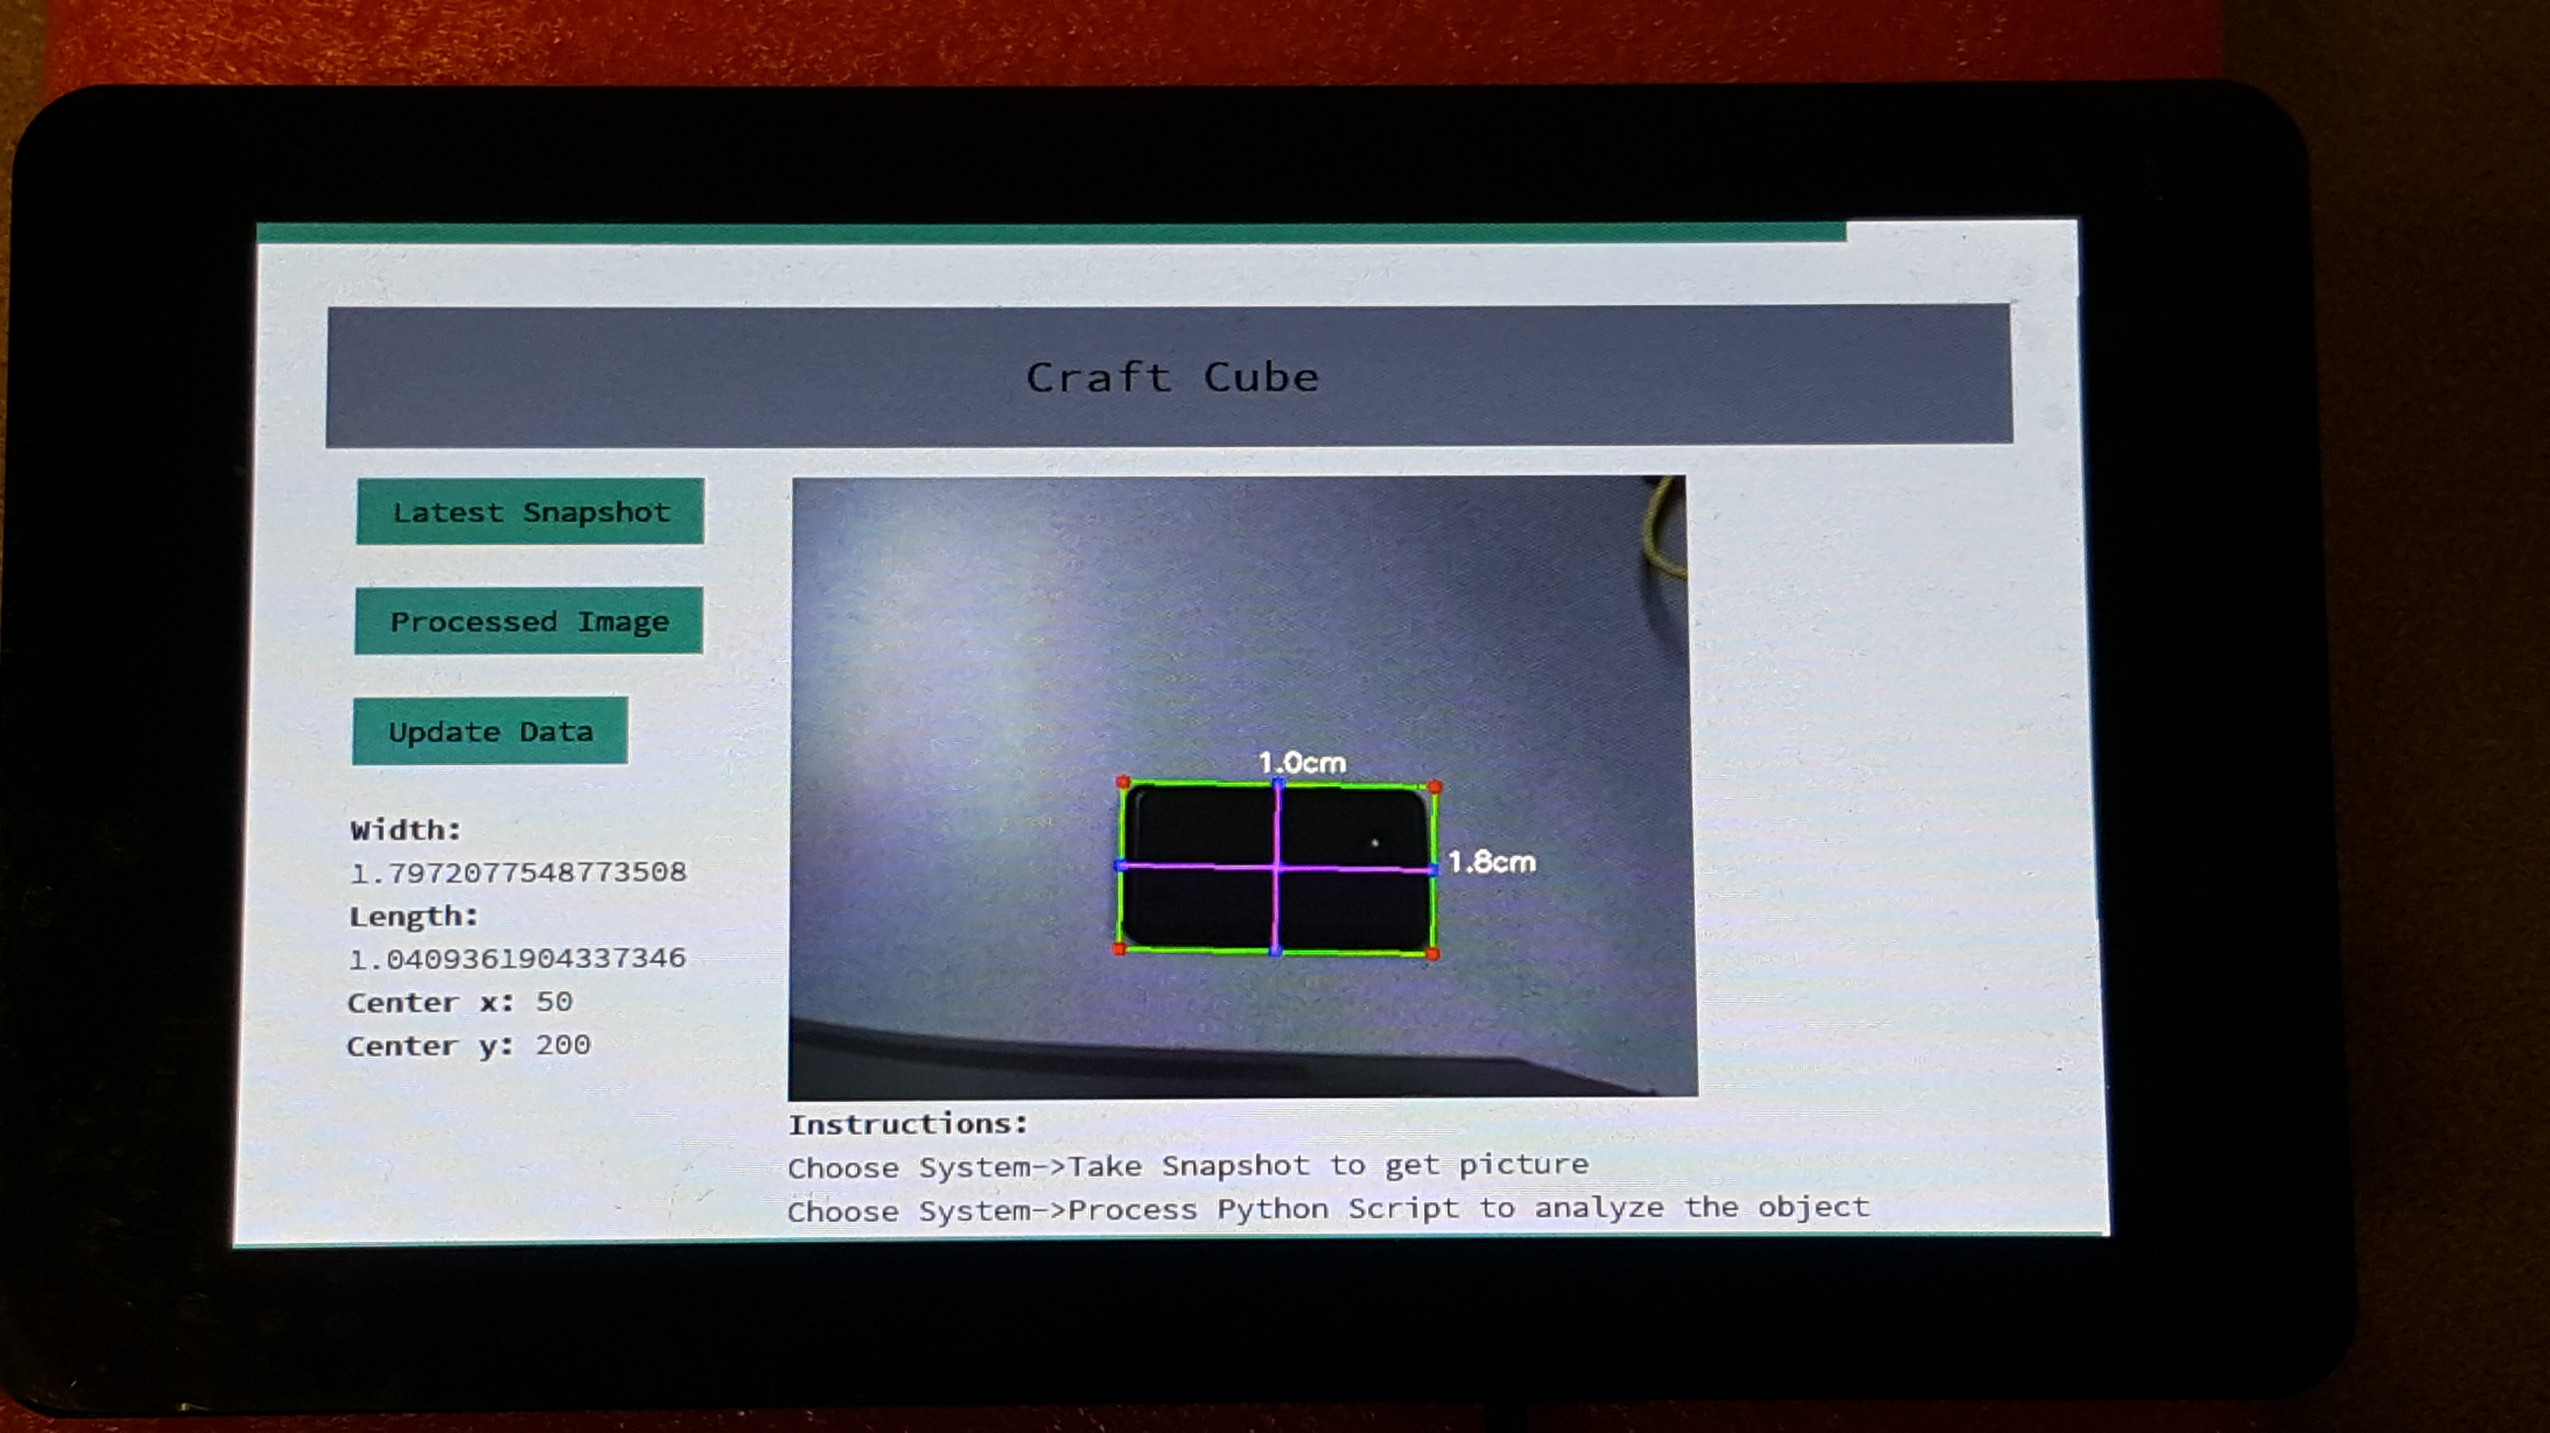
Craft Cube
2 in 1 CNC Machine
Ammar Ahmed, Thomas Bock, Michael Gomez, Tan Hua
Electrical and Electronic Engineering, California State University Sacramento
Hardware
Craft cube is a low cost 2 in 1 CNC Machine utilizing a user-friendly operating system. The design of the machine is constructed through 3D-Printed Parts available online. A Camera aide mounted on the end effector is used for image processing algorithm to determine the dimensions of the object.
Hardware
3D Model
Management
3D Print
Camera system
Laser Cutter/Engraver

